Slide 1



Sales Data Analysis Project
Using Python (Pandas, Matplotlib, Seaborn)
by Rahul Kumar Bhagat
Notes:
1

Slide 2

Introduction to the Project
This project analyzes sales data. We gain insights into key performance metrics. These include total sales, profit, and discounts. We use Python libraries for data visualization and interpretation.
Notes:
2

Slide 3





Tools and Technologies Used
Python
The core programming language for our analysis.
Pandas
Used for efficient data manipulation and structuring.
Matplotlib & Seaborn
Essential libraries for creating compelling data visualizations.
Jupyter / VS Code
Our chosen environments for interactive coding and development.
CSV Dataset
The raw data source for all sales information.
Notes:
3

Slide 4
Data Overview and Structure
Our dataset encompasses crucial sales details. It includes Order Date, Region, Sales, Profit, and Discount. Product Name and Category are also included. We loaded and explored the data using Pandas functions.
Order Date
Profit
Region
Discount
Sales
Product Name
Category
Notes:
4

Slide 5
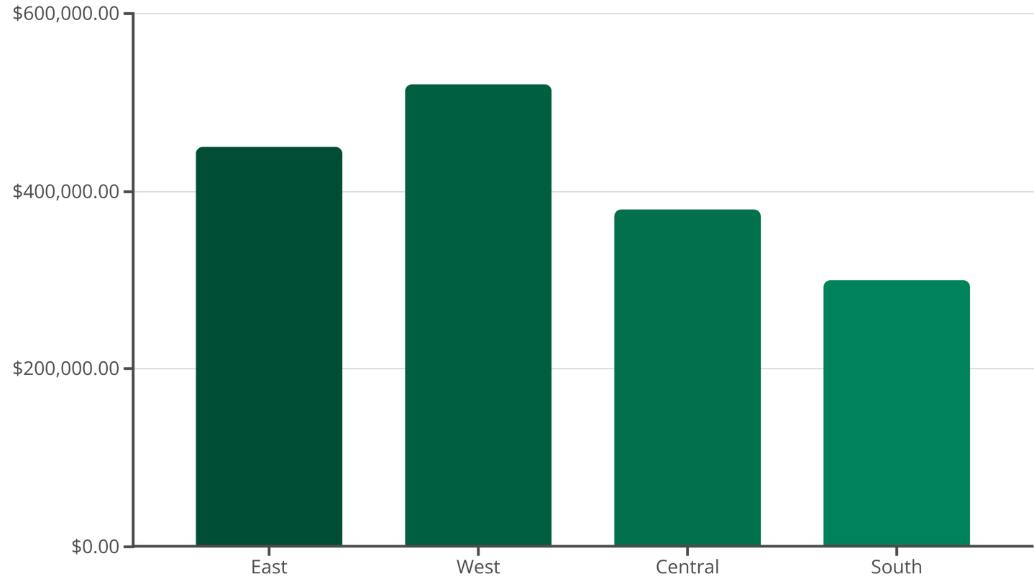
Sales Performance by Region
We grouped data by 'Region' to calculate total sales. This analysis reveals the geographic distribution of revenue. The bar chart visualizes regional contributions, highlighting top-performing areas.
Notes:
5

Slide 6
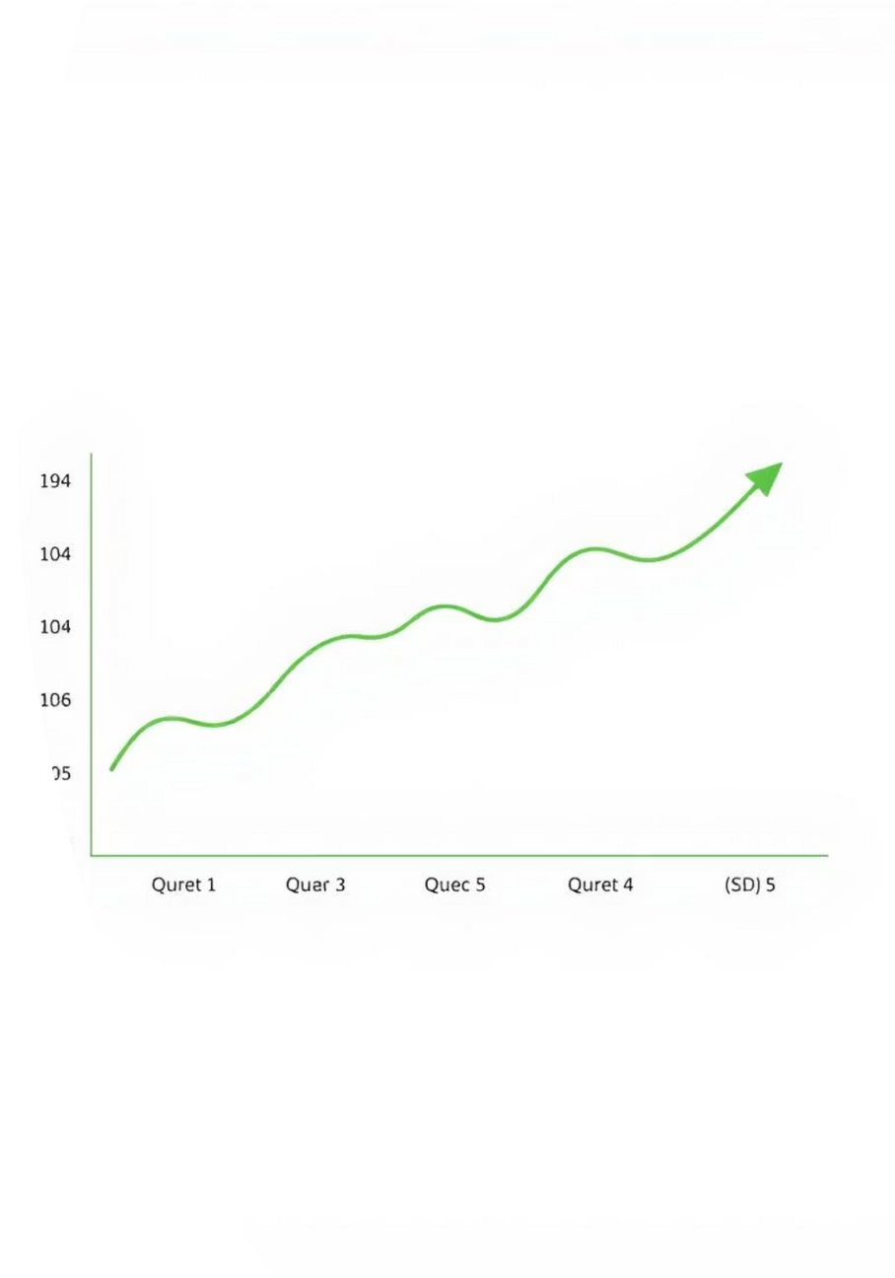

Time-Series Sales Trend Analysis
Order dates were converted to datetime objects. We then grouped sales by Month-Year. A line chart reveals seasonal patterns and long-term trends. This helps in forecasting future sales.
Notes:
6

Slide 7
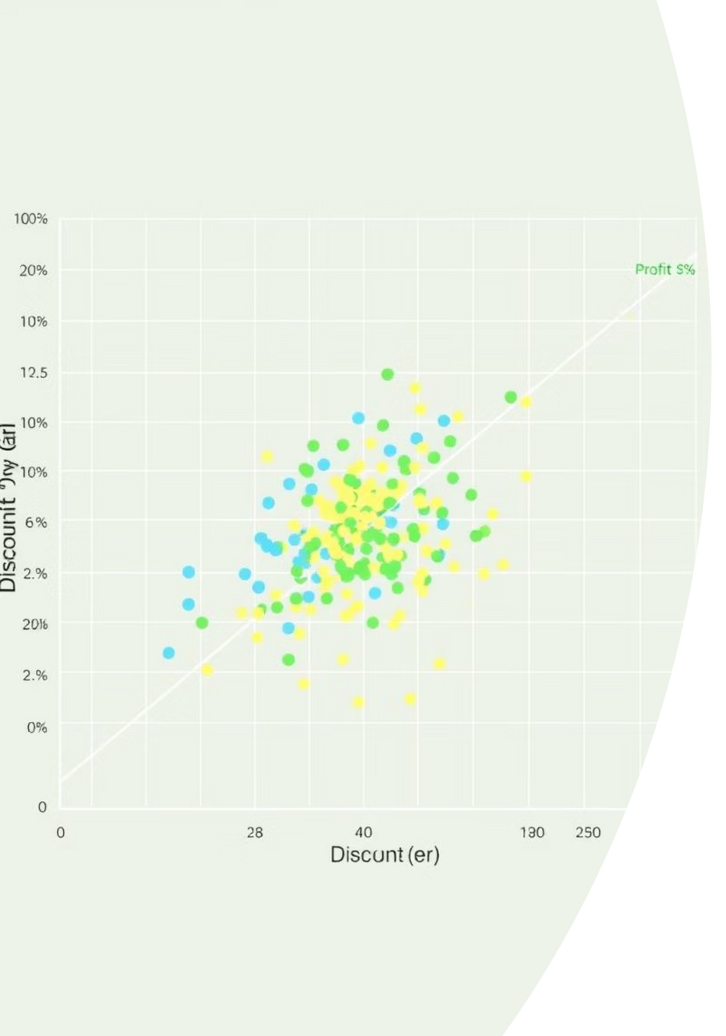
Profit Versus Discount Insights
A scatter plot illustrates the relationship between discount percentages and profit margins. We categorized data by product category. This helps identify optimal discount strategies. It balances sales volume with profitability.
Notes:
7

Slide 8
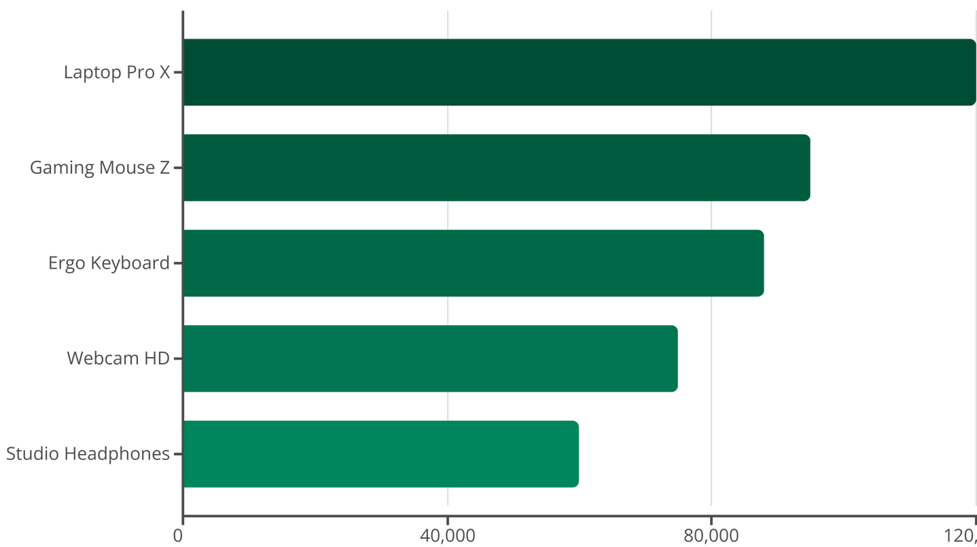
Identifying Top Selling Products
We identified the top 10 products by sales volume. Grouping and 'nlargest' functions were used for this. A horizontal bar chart visually represents these top performers. It highlights key revenue drivers.
Notes:
8

Slide 9

Key Insights Discovered
Regional Revenue Impact
Some regions significantly boost overall revenue. Focus marketing efforts here.
Discount Profit Link
Discounts often reduce profit margins. Review pricing strategies carefully.
Seasonal Sales Patterns
Sales exhibit clear seasonal trends. Optimize inventory and promotions accordingly.
Product Performance
Certain products consistently outperform others. Prioritize these high-value items.
Notes:
9

Slide 10


Conclusion and Next Steps
This sales data analysis offers valuable insights. It will guide strategic decisions in marketing and inventory. Businesses can now optimize product offerings. They can also refine promotional discounts and regional strategies. This data-driven approach fosters growth.
Notes:
10

Slide 11

Email: krrahul4507@gmail.com
Linkedin:https://www.linkedin.com/in/rahul-kumar-bhagat-04b898220
GitHub: https://github.com/Rahulkumar450
THANK YOU
for your Time

